Slide 1
Contemporary Moral Problems
M-F12:00-1:00SAV 264
Instructor: Benjamin Hole
Office Hours: everyday after class
Email: bvhole@uw.edu

Slide 2
Today’s Class
Agenda
Clicker Quiz
Argumentative Skill: Thought Experiments
Worries with Bentham
Hedonism and utilitarian theories of value
Nozick’s Argument
Distribution of pleasure

Slide 3
According to Bentham, considerations of pain and pleasure determine:
what we ought to do.
what we will do.
both a and b.
neither a nor b.

Slide 4
What does Nozick think we should conclude from the experience machine thought experiment?
Our experiences are not the only things that have value for us.
Pleasure and pain are the only things that are valuable for their own sakes.
Technological progress can have disastrous consequences.
We could be stuck in the Matrix.
Serving other people by improving their mental states is more important than seeking our own pleasure.

Slide 5
What does Nozick suggest that we desire that the experience machine can't provide?
To live in contact with reality.
To feel deeply loved.
To feel that we've achieved something truly great.
To never have to worry about the future.
All the above
None of the above

Slide 6
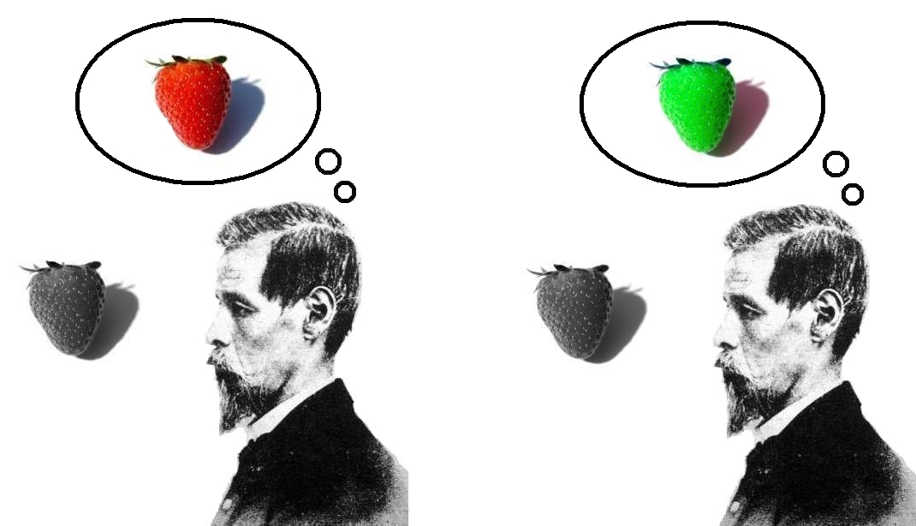
Thought Experiments
“are employed … by philosophers … to examine the implications of theories and to explore the boundaries of certain concepts”
(Honderich, T., The Oxford Companion to Philosophy, 2nd eds, OUP 2005, pg. 919)

Slide 7
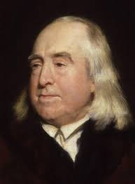
Summary of Bentham’s Hedonistic Utilitarianism
Theory of the good: HEDONISM
Theory of the right: UTILITARIANISM

Slide 8
Theories of Well-Being (Consequential Theories of Value)
Theories of well-being (or sometimes “happiness”) attempt to state what it is for a life to go well, and what kind of things make a life go better. They seek to specify what is intrinsically good for us.
Utilitarians ethical theory is value-based on a “Theory of the Good” about well-being.
Theories of Well-Being
Hedonism
Desire Satisfaction Theory
Objective List / Perfectionist

Slide 9
Hedonism
Hedonism states:
Pleasure is the only thing that is intrinsically good for people.
Pain is the only thing that is intrinsically bad for people.
Hedonism: X is valuable if and only if (and because) X is pleasurable.

Slide 10
Desire Satisfaction Theory
Desire Satisfaction Theory States
If something is good for us, then it fulfills our desires.
If something fulfills our desires, then it is good for us.
DST: X is valuable if and only if (and because) X satisfies a desire

Slide 11
Objective List / Perfectionist Theory
Objective List / Perfectionist Theory States
If something is good for us, then it is an item on an objective list of values, which may include items such as knowledge and achievement.
If something is on an objective list of values, then it is good for us.
OL/PT: X is valuable if and only if (and because) X satisfies is on an objective list of values.

Slide 12
Bentham’s Hedonistic Utilitarianism
Theory of the good: HEDONISM
Theory of the right: UTILITARIANISM

Slide 13

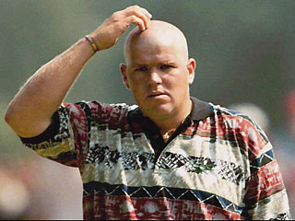
Problems with Bentham’s Hedonistic utilitarianism
(2) Pleasures are quantifiable. Compare falling in love to scratching your head.

Slide 14
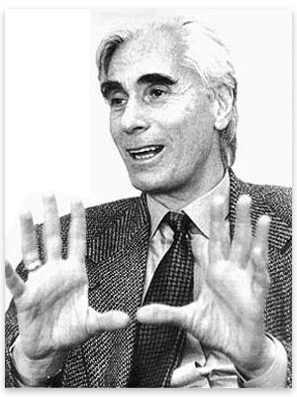
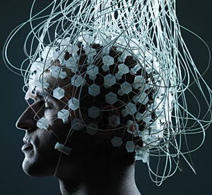
Problems with Bentham’s Hedonistic utilitarianism
Values are sensations, says Bentham. Does this adequately reflect how we understand the world?

Slide 15
Hedonism
Hedonism: Pleasure is the one and only value and pain is the one and only disvalue.
Nozick
Is pleasure really the one and only value?
“thought experiments are employed … by philosophers … to examine the implications of theories and to explore the boundaries of certain concepts”
(Honderich, T., The Oxford Companion to Philosophy, 2nd eds, OUP 2005, pg. 919)

Slide 16
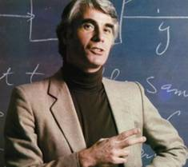
Robert Nozick
“Suppose there were an experience machine that would give you any experience you desired. Superduper neuropsychologists could stimulate your brain so that you would think and feel you were …
“Should you plug into this machine for life, preprogramming your life’s experiences?”

Slide 17
Nozick
Hedonism: Pleasure is the one and only value and pain is the one and only disvalue.
Main Argument
If hedonism is true, then we would plug into the experience machine.
But we would not plug into the machine.
Therefore, hedonism is not true.
Modus Tollens

Slide 18
PREMISE 2: “we [I] would not plug into the machine.”
Strongly Agree
Agree
Somewhat Agree
Neutral
Somewhat Disagree
Disagree
Strongly Disagree

Slide 19
Nozick
Premise Two: But we would not plug into the machine.
Discussion Question: Would you plug into the machine?
Identify 1-3 reasons why or why not.

Slide 20
Nozick
Premise Two: But we would not plug into the machine.
“First, we want to do certain things, and not just have the experience of doing them”

Slide 21
Nozick
Premise Two: But we would not plug into the machine.
“A second reason for not plugging in is that we want to be a certain way, to be a certain kind of person”

Slide 22
Nozick
Premise Two: But we would not plug into the machine.
“Thirdly, plugging into an experience machine limits you to a man-made reality, to a world no deeper or more important than that which people can construct”

Slide 23
Hedonism: Pleasure is the one and only value and pain is the one and only disvalue.
Strongly Agree
Agree
Somewhat Agree
Neutral
Somewhat Disagree
Disagree
Strongly Disagree

Slide 24
Objection to Nozick
The Reductionist Move
The Fetishism Problem
All other apparent values are only instrumentally valuable.
Hedonism: Pleasure is the one and only value and pain is the one and only disvalue.

Slide 25
Bentham’s Hedonistic Utilitarianism
One last objection about the distribution of pleasure.

Slide 26
Problems with Bentham’s Hedonistic Utilitarianism
Distribution. Utilitarianism only wants the total to be maximized; it doesn’t care about the distribution. This can lead to some results we might not be able to accept.
Variants: Aggregation objection, scapegoat objection, justice objection, rights objection, fairness objection.

Slide 27
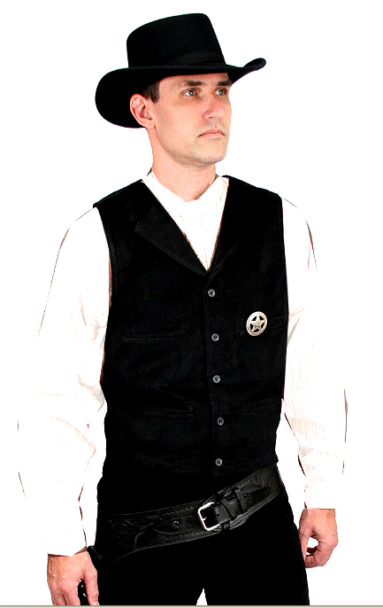
Imagine the following case:
You are a sheriff, and in your jail is a man you know to be innocent. A mob is threatening to riot unless they are allowed to kill the man. You know that the riot will cause more pain, including more death, than the killing of the innocent man.
Do you allow the mob to kill your prisoner?

Slide 28

Consider the following two worlds:
World one:
100 people
10 utils per person
= 1000 utils
World two:
Ron gets ritually beaten.
Ron at negative 100 utils;
99 people get 12 utils per person
= 1088 utils
Ron Keller being scapegoated makes the world happier, but is it fair?

Slide 29


Consider the following two islands:
Normalia:
10 people
10 utils each
= 100 total utils
Denseria:
100 people
2 utils each
= 200 utils

Slide 30
Bentham’s Hedonistic Utilitarianism
Strongly Agree
Agree
Somewhat Agree
Neutral
Somewhat Disagree
Disagree
Strongly Disagree

